Slide 1
ENGGEN 726
Mission Bay's Future: A Coastal Adaptation Strategy
24/10/2025
Haochen Zhang 143344080

Slide 2
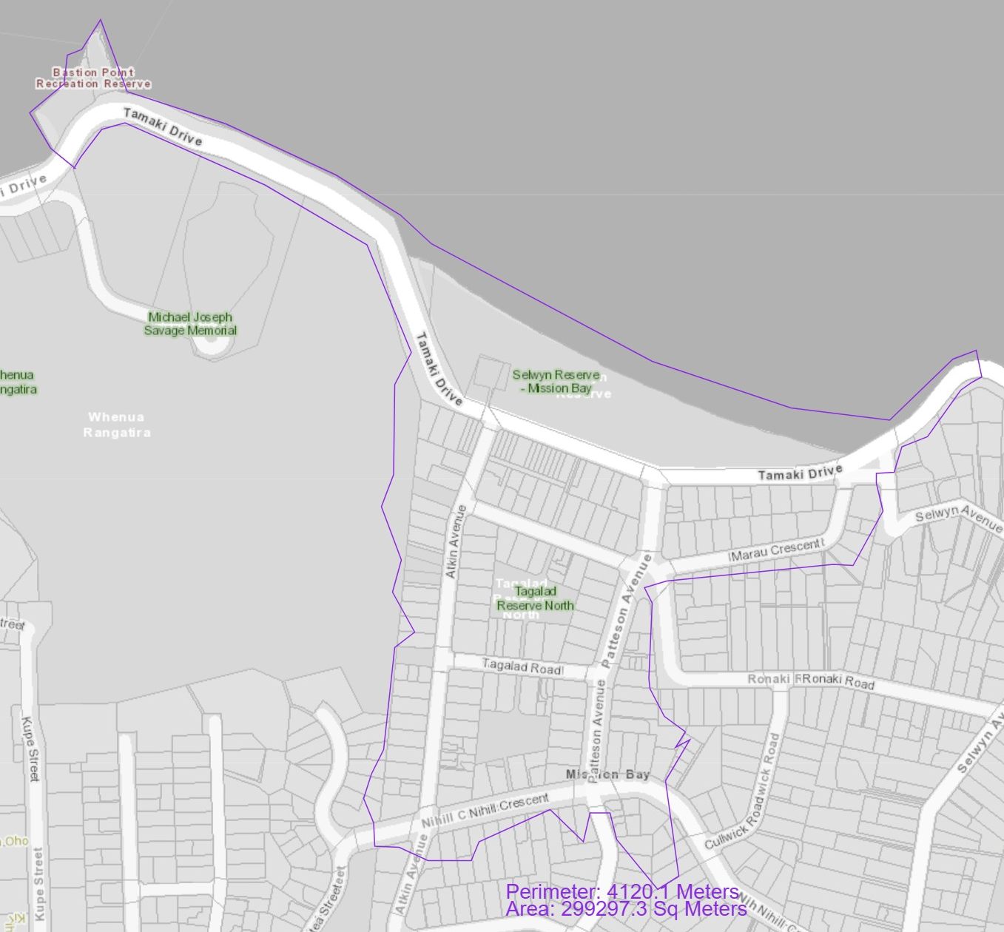
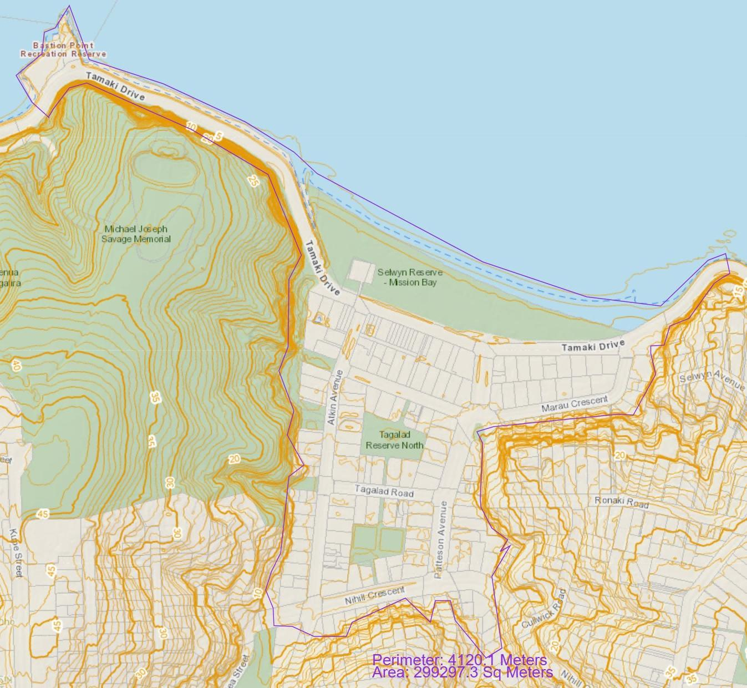
Study Area
The study area comprises the Mission Bay shoreline and back-beach neighbourhood along Tamaki Drive, from Bastion Point to the eastern bend of Tamaki Drive (~1.45 km of coast).
The seaward boundary follows the mapped coastal-inundation envelope. The landward boundary follows the landward extent of Auckland Council GeoMaps’ coastal-inundation layer for 18.1% AEP with +2.0 m sea-level rise.
Topographically, the area forms a saddle, with low flats flanked by higher ground to the west and east.

Slide 3
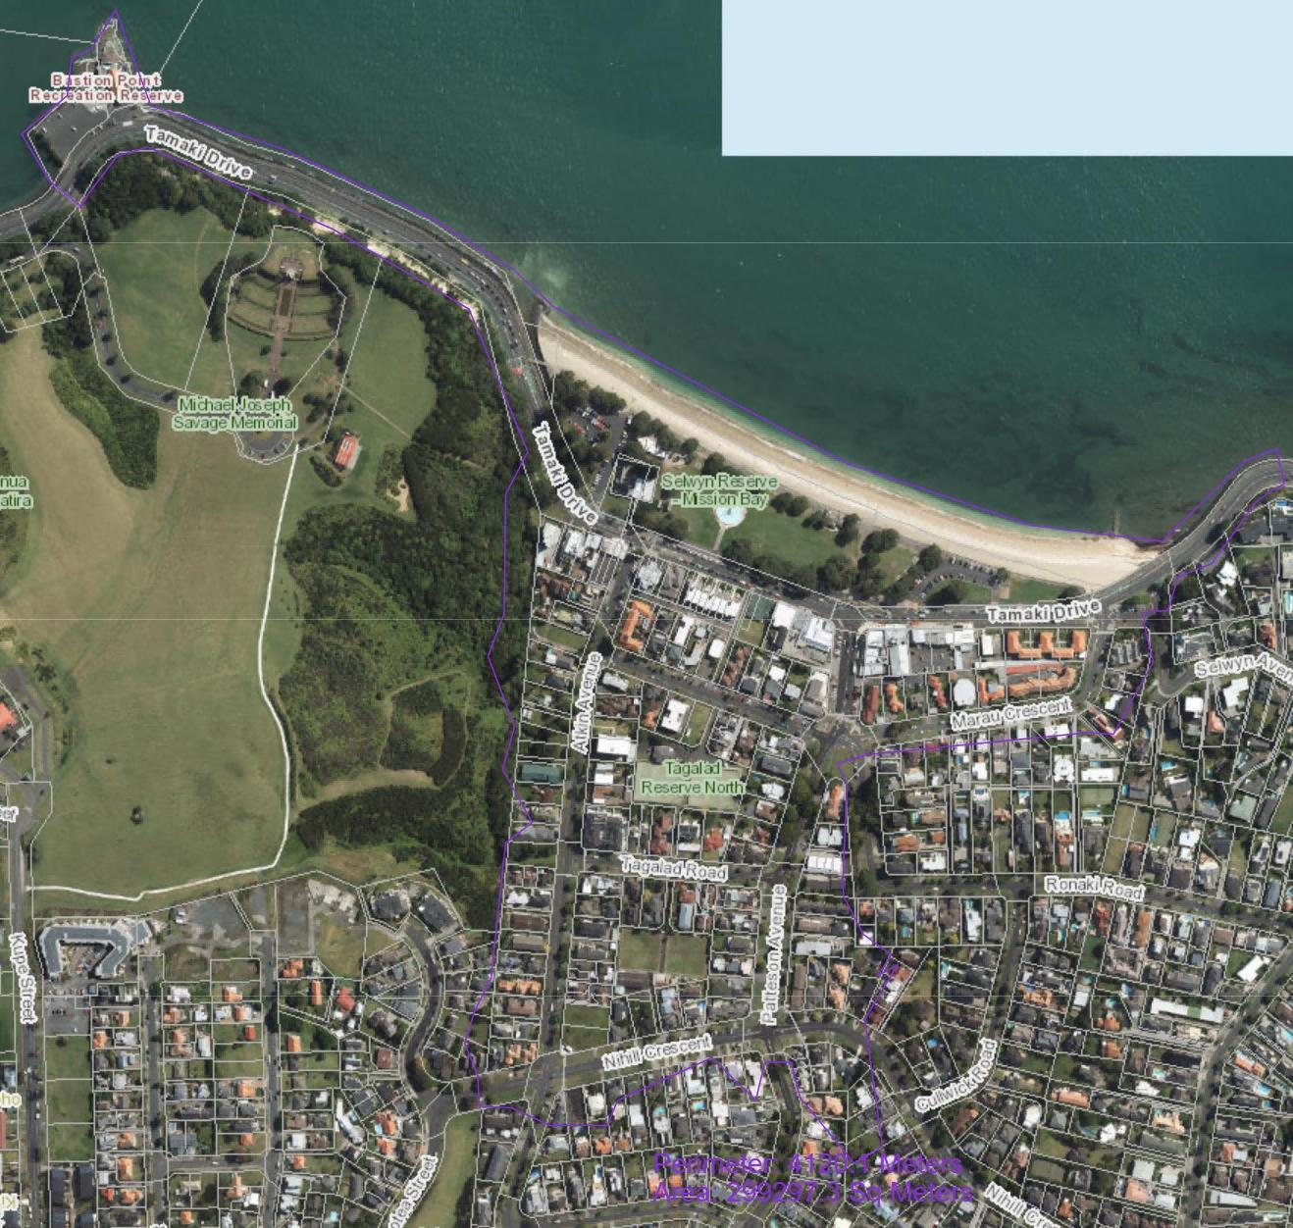
Assets Considered within the
Area
Tamaki Drive coastal section
Hard coastal structures
Residential blocks
Local street network in the back-beach blocks
Mission Bay beach and foredune
Selwyn Reserve
Tagalad Reserve North
Bastion Point Recreation Reserve

Slide 4
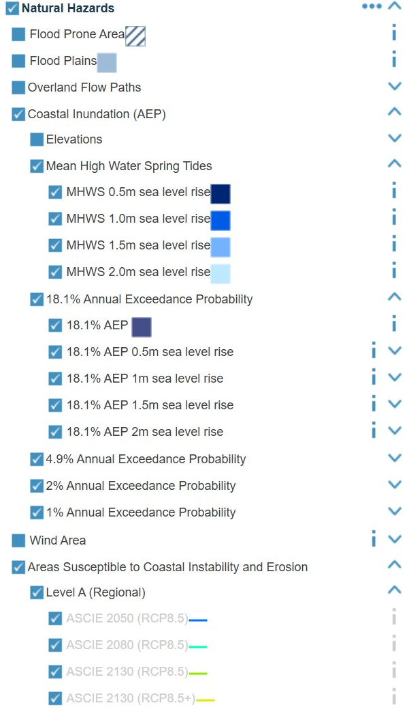
Hazard Types
Coastal Inundation
Short-term marine flooding of the shore belt and back-beach flats driven by tides, storm surge and sea-level rise (SLR). Two map families are used:
Mean High Water Spring Tides (MHWS) + SLR (0.5 - 2.0)
Storm-tide AEP (18.1%, 4.9%, 2%, 1%) + SLR (0.5 - 2.0)
Coastal Erosion
Progressive landward retreat of the active beach edge under waves, storms and SLR.
The assessment uses ASCIE Level A (Regional) lines for 2050, 2080, 2130 (RCP8.5 / 8.5+).

Slide 5
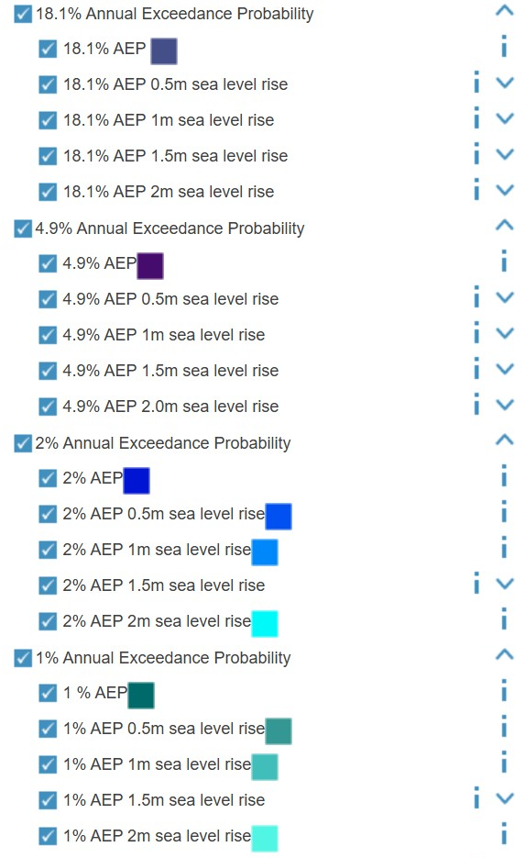
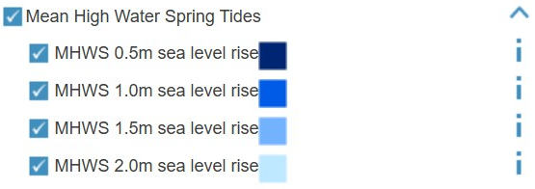
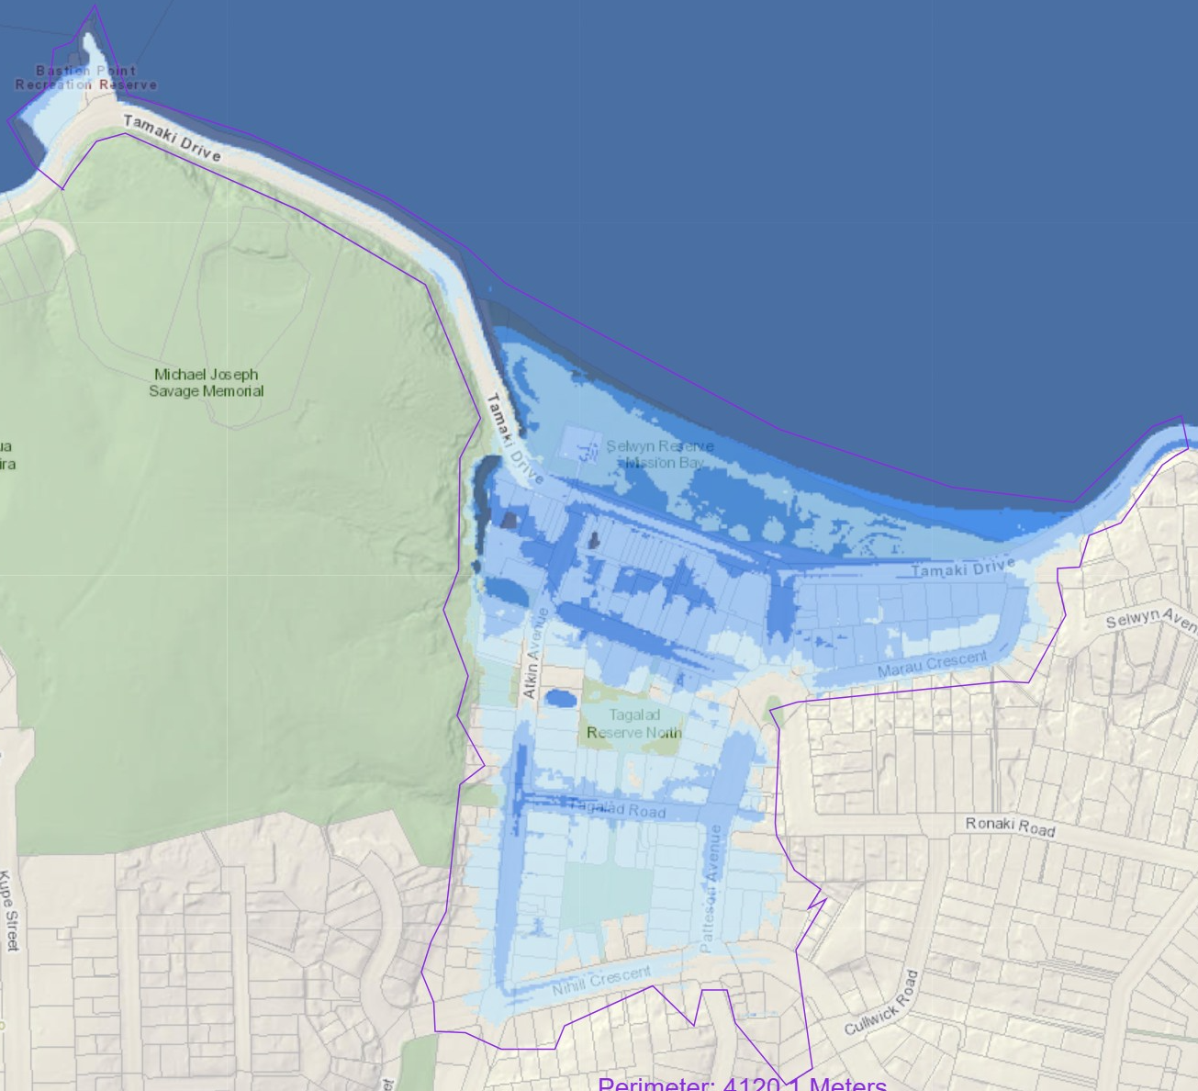
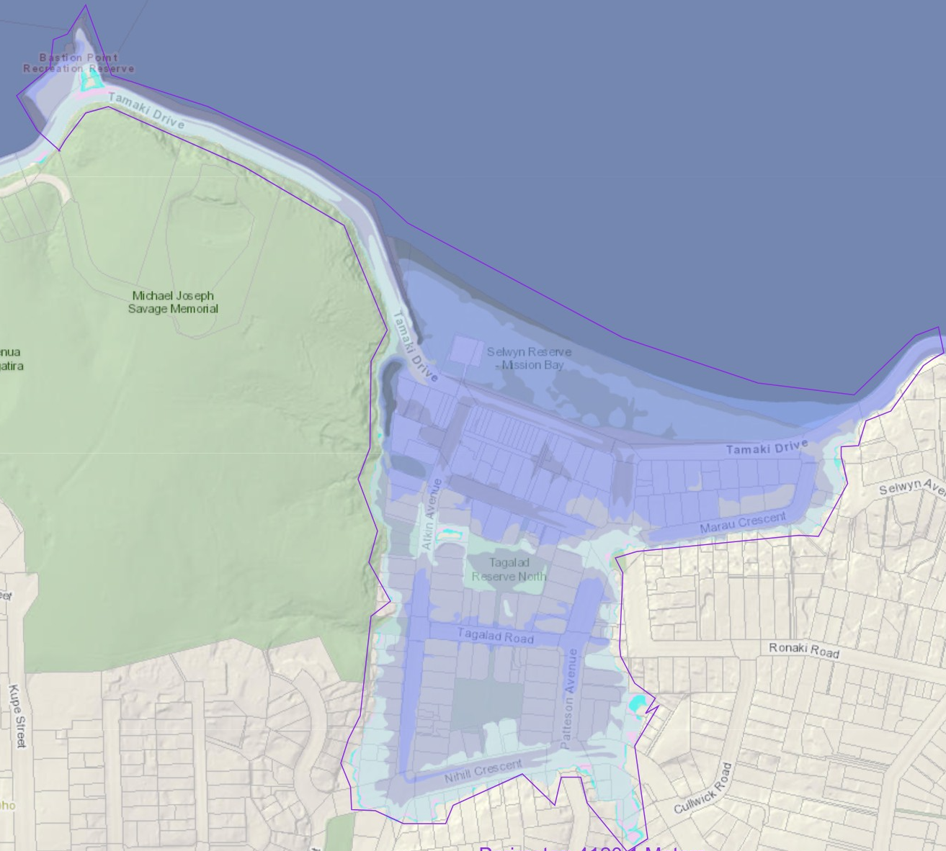
Coastal Inundation Results

Slide 6
Coastal Inundation Results
MHWS + SLR
With a fixed MHWS baseline, exposure is driven mainly by the SLR step. The footprint expands from +0.5 to +2.0 m.
SLR +0.5 m: Inundation mostly on the beach. Tamaki Drive lanes largely unaffected.
SLR +1.0 m: A continuous shallow band forms landward of the seawall and noticeable ponding in Selwyn Reserve.
SLR +1.5 m: Water reaches several low points on Tamaki Drive and enters the first row of residential lots and short flooded sections on local streets.
SLR +2.0 m: Inundation extends into the back-beach blocks. A near-continuous wet corridor forms along Tamaki Drive.

Slide 7
Coastal Inundation Results
Storm-tide AEP + SLR
Across the four storm-tide AEP layers with same SLR +0.5–2.0 m, the mapped inundation extents are almost identical. Only small differences appear in the southern low-lying pocket. Changes in exposure are driven mainly by the SLR step, not by the AEP level.
SLR +0.5 m: Inundation is mostly limited to the beach. Minor ponding occurs at low points along the seawall. Road lanes are largely unaffected.
SLR +1.0 m: A continuous shallow band forms landward of the seawall. Noticeable ponding appears in Selwyn Reserve.
SLR +1.5 m: The hazard footprint begins to reach low spots on Tamaki Drive and enters the first row of residential lots. Several local streets show short flooded sections.
SLR +2.0 m: Inundation extends deep into the back-beach blocks. Hard coastal structures are within a zone of strong wave action.

Slide 8
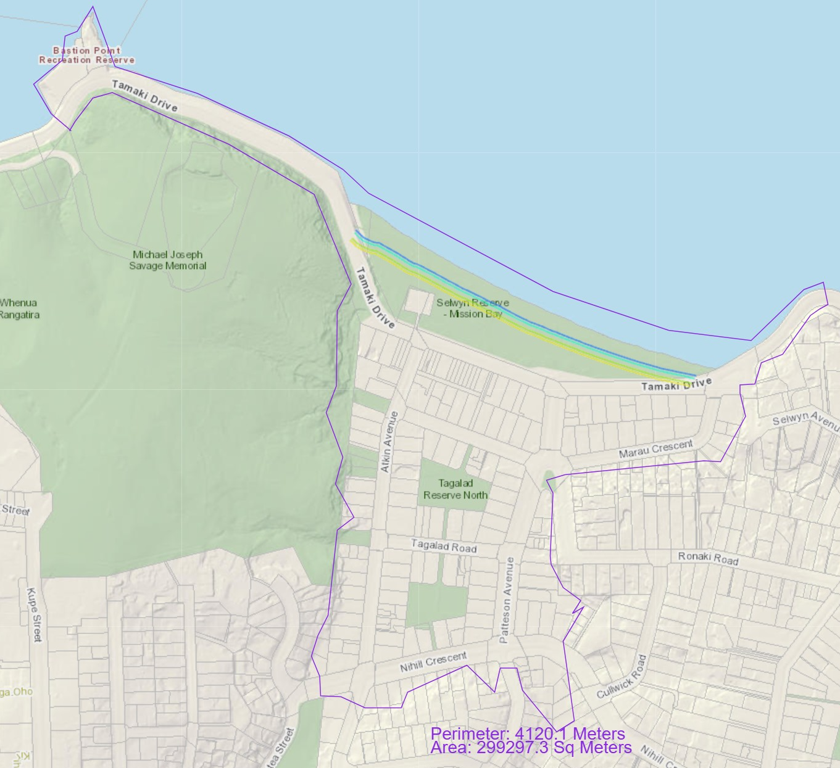
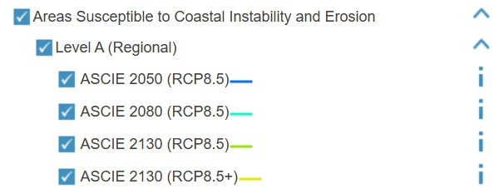
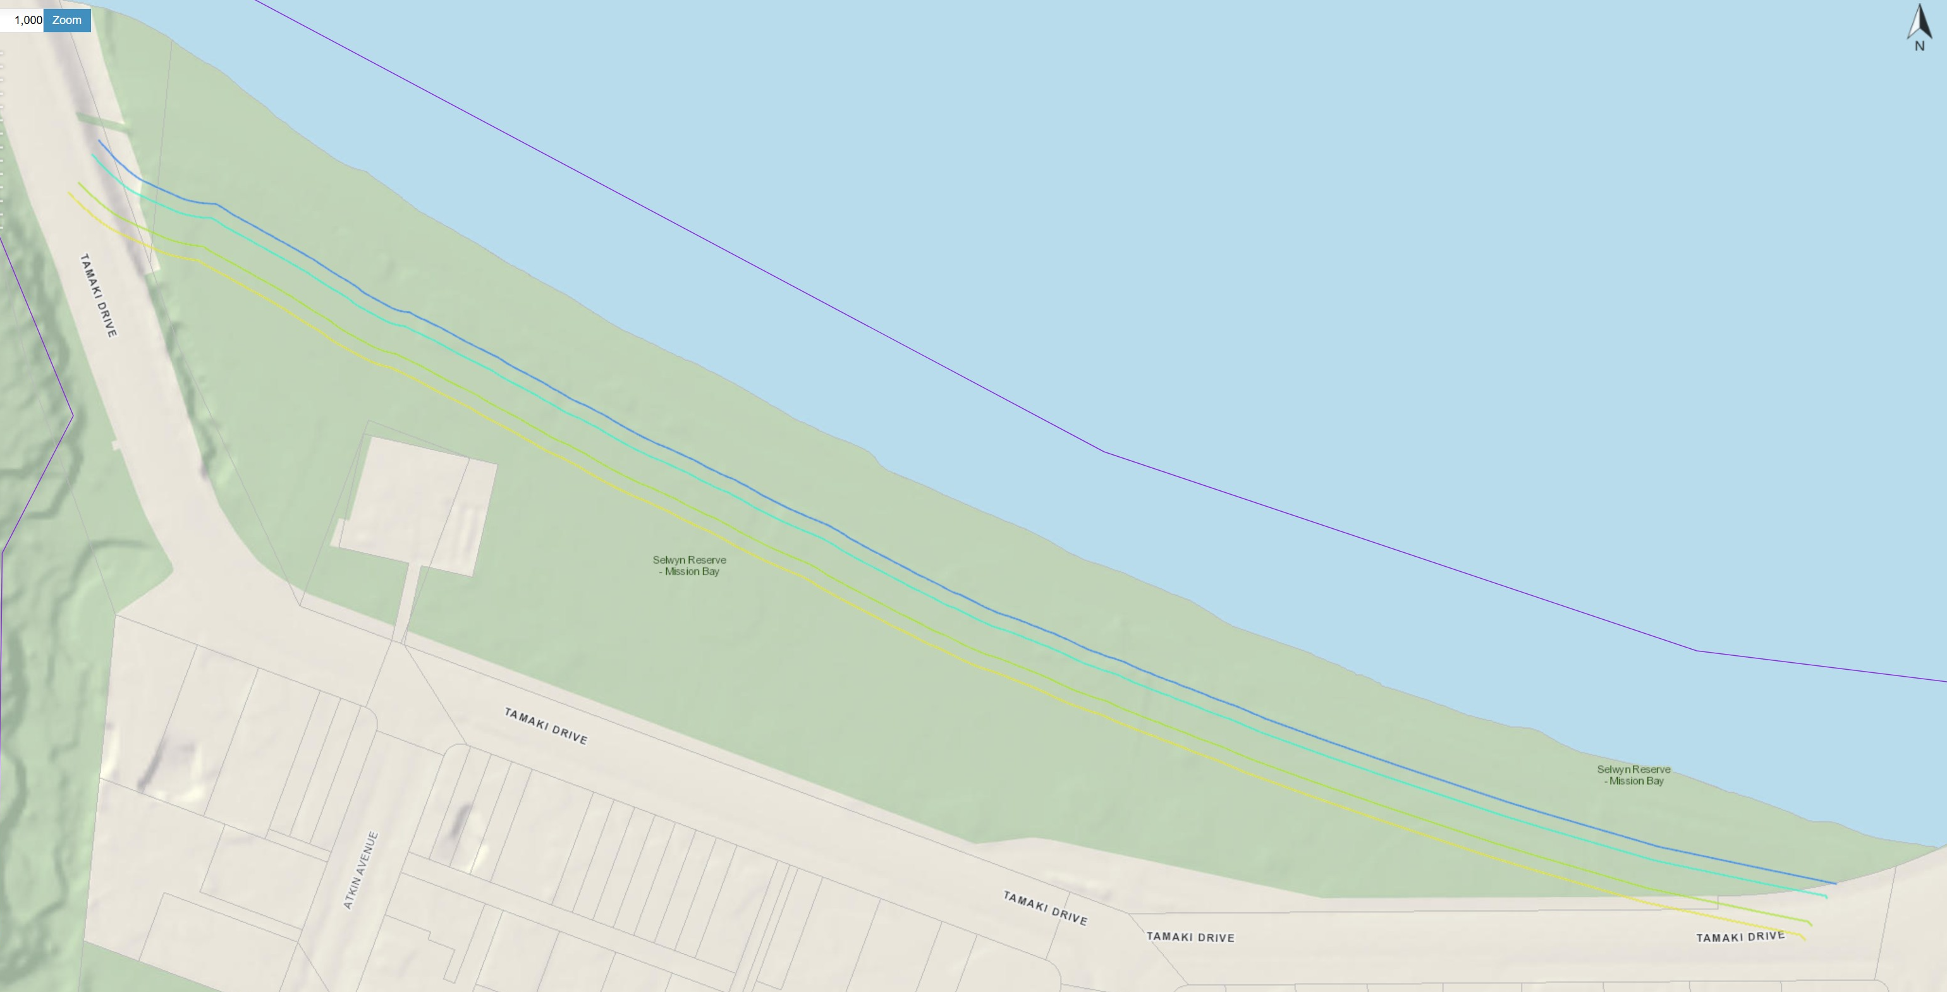
Coastal Erosion Results

Slide 9
Coastal Erosion Results
ASCIE (Level A, RCP8.5/8.5+) appears only along the sandy pocket at Mission Bay.
The lines step landward from 2050 to 2130 (RCP8.5+), forming a narrow band across the upper beach and foredune. No lines are mapped on the rocky coasts at Bastion Point or at the eastern end, indicating low erosion susceptibility there.
The most exposed assets are the Mission Bay beach and foredune, the coastal shared path and boardwalk and seawall edge, and the seaward frontage of Selwyn Reserve.
Tamaki Drive generally lies landward of the lines, with exposure increasing to moderate where the beach approaches the road mid-bay. The residential blocks remain outside the 2130 line.

Slide 10
Risk Analysis
Step 1 - Asset-level exposure mapping: Eight asset classes within the study area were intersected in GeoMaps with each hazard layer. Resulting overlaps were classified as low/medium/high (L/M/H) exposure.
Step 2 - Scenario aggregation: For each hazard scenario (MHWS+SLR, storm-tide AEP+SLR, ASCIE) asset-level exposures were combined to derive an Aggregated Exposure level for the study area.
Step 3 - System vulnerability evaluation: Vulnerability was assigned at the system level through local topography, coastal protection context, with scenario-specific adjustments.
Step 4 - Consequence evaluation: A matrix was applied (Consequence = Aggregated Exposure × Vulnerability) to produce severity classes (Insignificant/Minor/Moderate/Major) used to inform adaptation options.

Slide 11
Risk Analysis
Type | Year/SLR | Storm | Tamaki Drive (Exposure) | Local Streets (Exposure) | Hard Structures (Exposure) | Residential Blocks (Exposure) | Beach & Foredune (Exposure) | Selwyn Reserve (Exposure) | Tagalad Reserve North (Exposure) | Bastion Point Recreation Reserve (Exposure) | Aggregated Exposure | Aggregated Vulnerability | Aggregated Consequence
MHWS | 0.5M | - | L | L | M | L | H | L | L | L | L | L | Insignificant
MHWS | 1.0M | - | M | M | H | L | H | M | L | L | M | M | Moderate
MHWS | 1.5M | - | H | H | H | M | H | H | L | L | H | H | Major
MHWS | 2.0M | - | H | H | H | H | H | H | H | M | H | H | Major
Inundation | 0M | 18.1% AEP | L | L | M | L | H | L | L | L | L | L | Insignificant
Inundation | 0.5M | 18.1% AEP | L | L | M | L | H | M | L | L | L | L | Insignificant
Inundation | 1.0M | 18.1% AEP | M | M | H | M | H | H | L | L | H | M | Major
Inundation | 1.5M | 18.1% AEP | H | H | H | H | H | H | H | M | H | H | Major
Inundation | 2.0M | 18.1% AEP | H | H | H | H | H | H | H | H | H | H | Major
Inundation | 0M | 4.9% AEP | L | L | M | L | H | L | L | L | L | L | Insignificant
Inundation | 0.5M | 4.9% AEP | L | L | M | L | H | M | L | L | L | L | Insignificant
Inundation | 1.0M | 4.9% AEP | M | M | H | M | H | H | L | L | H | M | Major
Inundation | 1.5M | 4.9% AEP | H | H | H | H | H | H | H | M | H | H | Major
Inundation | 2.0M | 4.9% AEP | H | H | H | H | H | H | H | H | H | H | Major
Inundation | 0M | 2% AEP | L | L | M | L | H | L | L | L | L | L | Insignificant
Inundation | 0.5M | 2% AEP | L | L | M | L | H | M | L | L | L | L | Insignificant
Inundation | 1.0M | 2% AEP | M | M | H | M | H | H | L | L | H | M | Major
Inundation | 1.5M | 2% AEP | H | H | H | H | H | H | H | M | H | H | Major
Inundation | 2.0M | 2% AEP | H | H | H | H | H | H | H | H | H | H | Major
Inundation | 0M | 1% AEP | L | L | M | L | H | L | L | L | L | L | Insignificant
Inundation | 0.5M | 1% AEP | L | L | M | L | H | M | L | L | L | L | Insignificant
Inundation | 1.0M | 1% AEP | M | M | H | M | H | H | L | L | H | M | Major
Inundation | 1.5M | 1% AEP | H | H | H | H | H | H | H | M | H | H | Major
Inundation | 2.0M | 1% AEP | H | H | H | H | H | H | H | H | H | H | Major
Erosion | ASCIE 2050 (RCP8.5) | - | L | L | M | L | H | M | L | L | L | L | Insignificant
Erosion | ASCIE 2080 (RCP8.5) | - | M | L | M | L | H | H | L | L | M | L | Minor
Erosion | ASCIE 2130 (RCP8.5) | - | M | L | H | L | H | H | L | L | H | M | Major
Erosion | ASCIE 2130 (RCP8.5+) | - | M | L | H | L | H | H | L | L | H | M | Major

Slide 12
Pathway Adaptation
Baseline Adaptation
Adaptation Signal
Protect
Transfer Point
Accommodate
Managed Retreat
Site-wide Adaptation
Tamaki Drive
Reserves & Beach
Residential Area
0m
0.5m
1.0m
1.5m
2.0m

Slide 13
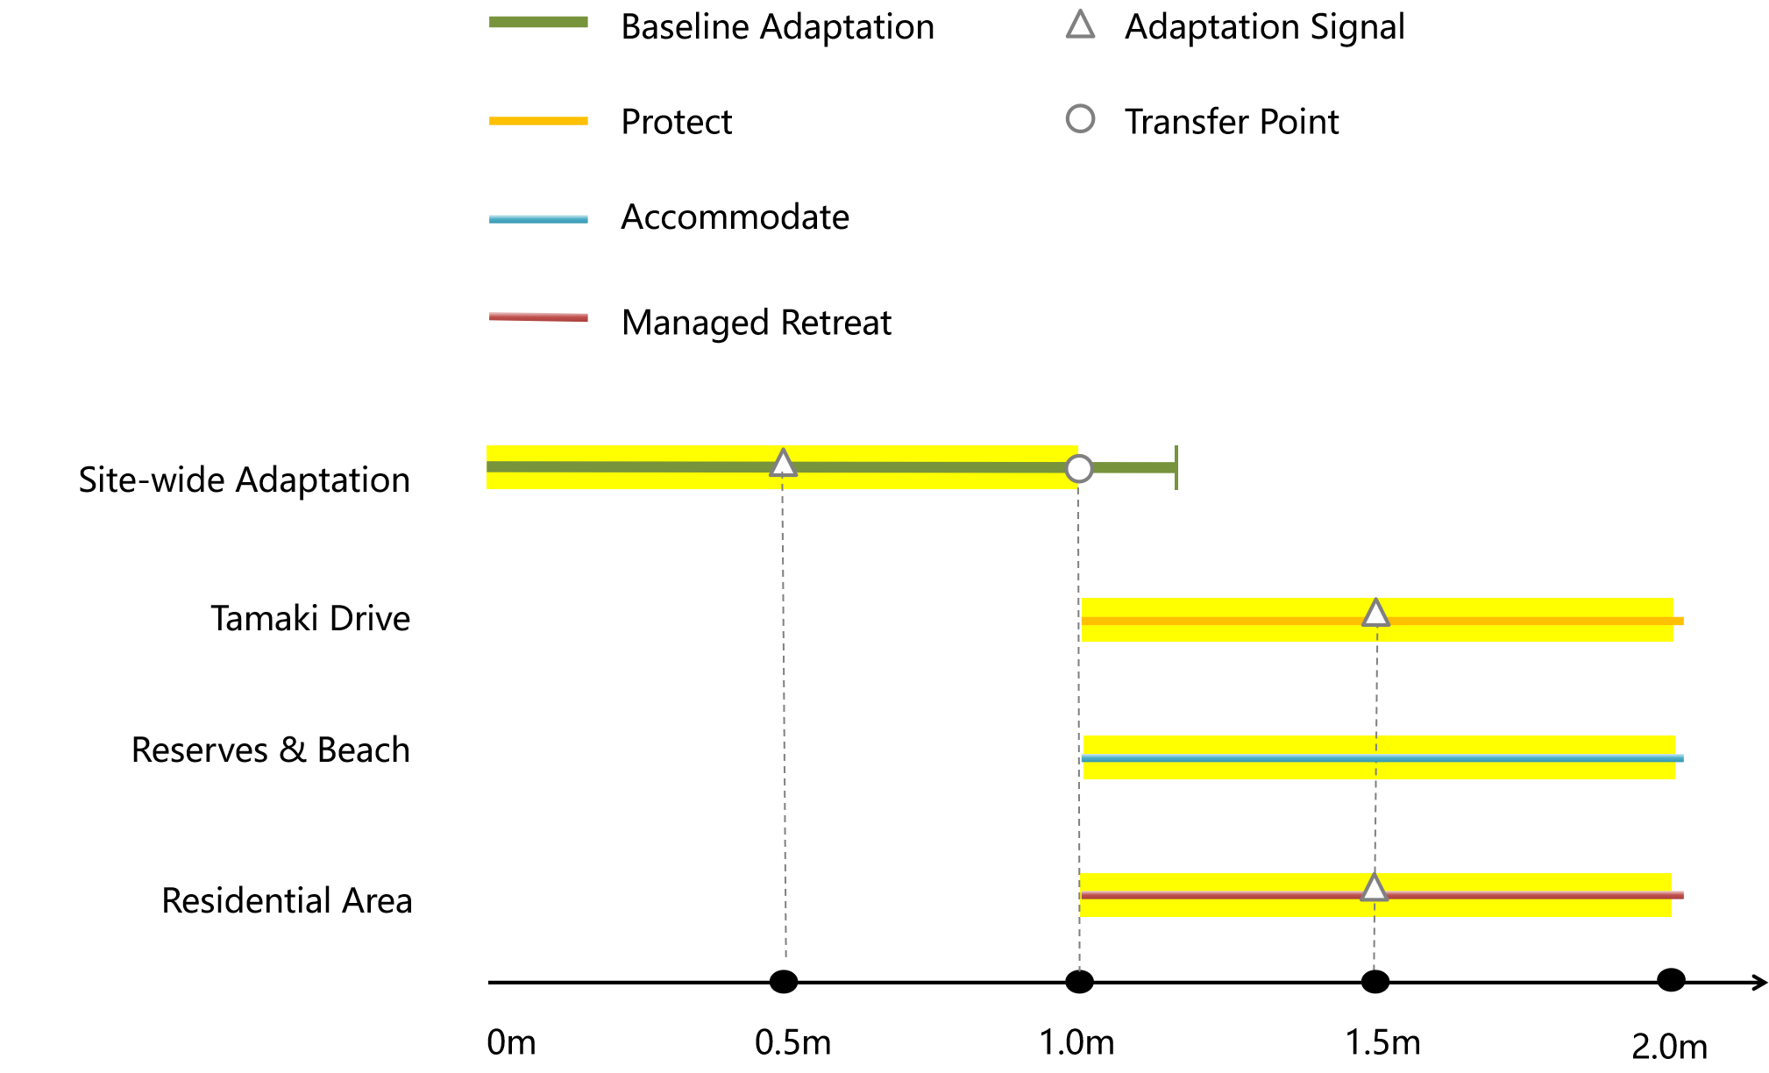
Pathway Adaptation
Unified Baseline Adaptation Stage
(0m - +1.0m SLR)
In the initial stages of sea-level rise (0m to +1.0m), a unified site-wide strategy of maintenance and incremental defence is adopted. Up to +0.5m, the focus is on fixing backflow risk points, minor raising of crests and kerbs, lifting critical path nodes, and commencing dune restoration with annual monitoring.
As SLR approaches +1.0m, actions escalate to incremental topping-up and sealing of weak seawall segments, establishing floodable lawns and linear storage at the reserves, and providing self-protection guidance for first-row properties while adjusting maintenance standards for more frequent inspections.

Slide 14
Pathway Adaptation
Lifeline Protection (> +1.0m SLR)
Beyond +1.0m SLR, Tamaki Drive requires robust protection as lifeline infrastructure. Between +1.0m and +1.5m, actions include re-grading the road to raise sags, preparing rapid-deployment barrier nodes, adding toe dissipation and anti-scour works, and raising or duplicating critical utilities as required.
Beyond +1.5m, the strategy shifts to transformative engineering, aiming to establish a continuous elevation and water-tightness line along the entire corridor.

Slide 15
Pathway Adaptation
Public Space Accommodation (> +1.0m SLR)
Public spaces and beaches adopt an 'Accommodate' pathway, living with water. Key actions include ongoing beach nourishment to reach design volumes and transitioning areas like Selwyn Reserve from purely recreational spaces into zones with active flood management functions, accepting their role as temporary buffers during storms.

Slide 16
Pathway Adaptation
Residential Managed Retreat (> +1.0m SLR)
Residential areas transition gradually from 'Accommodate' to 'Managed Retreat' starting at +1.0m SLR. The initial focus (+1.0m to +1.5m) is on enabling ground-floor use conversion to non-residential purposes and adopting floodable building designs.
Beyond +1.5m, or if annual inundation thresholds are persistently exceeded, a full retreat strategy is triggered: securing reserved retreat corridors, utilizing planning tools to limit new risks, and commissioning feasibility and funding studies for selective relocation.

